Slide 1
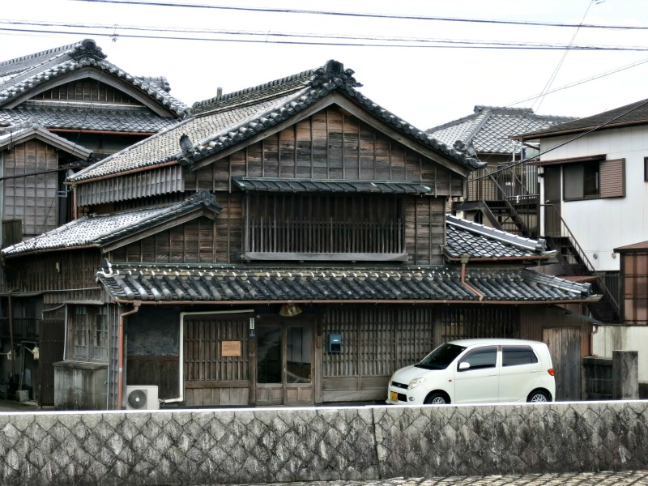
Typical Japanese houses

Slide 2
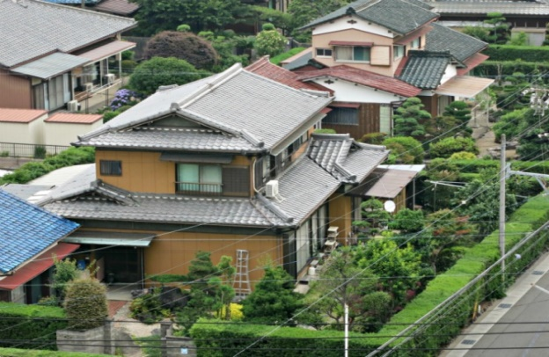
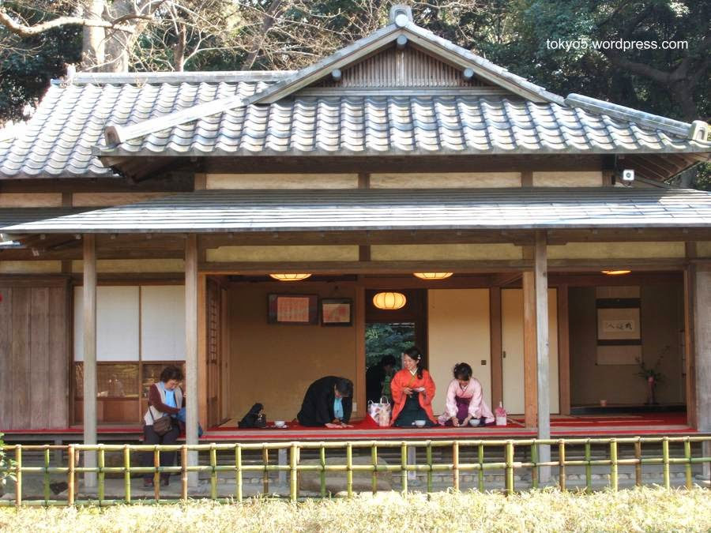
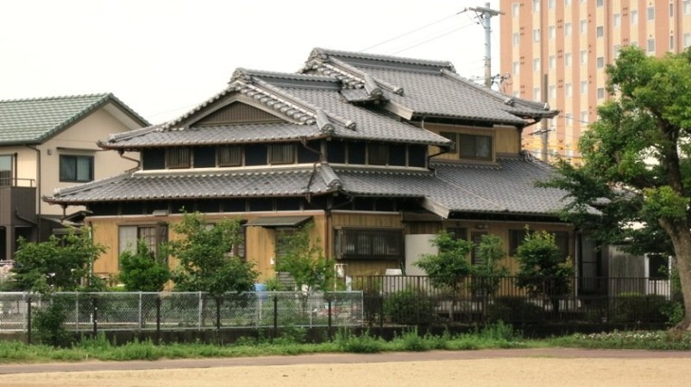
Structure
The roof is on slope and extended. It is supported by columns and beams.

Slide 3
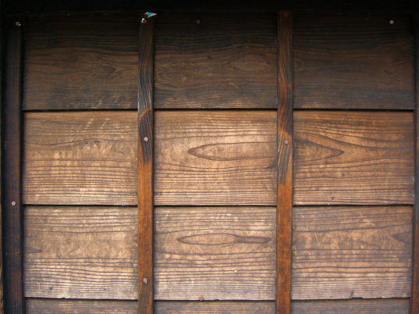
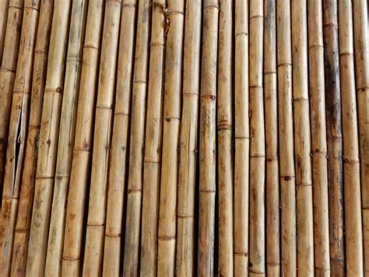
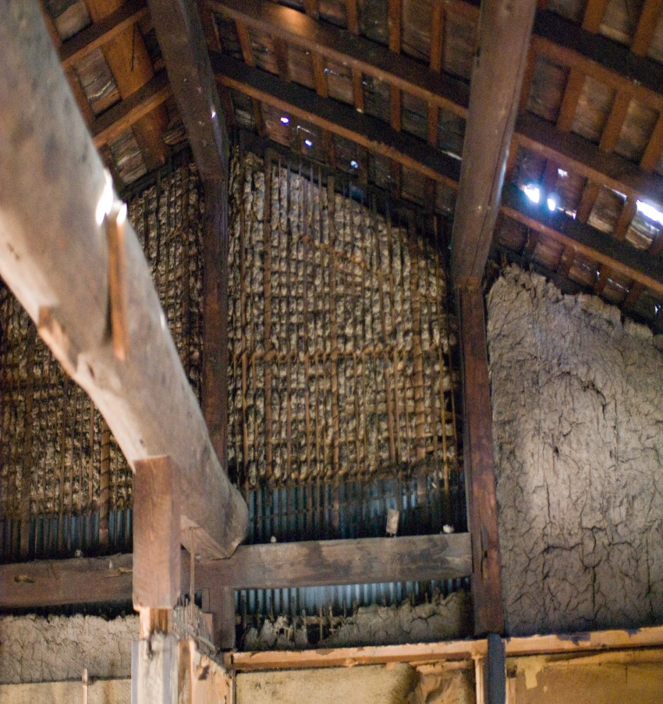
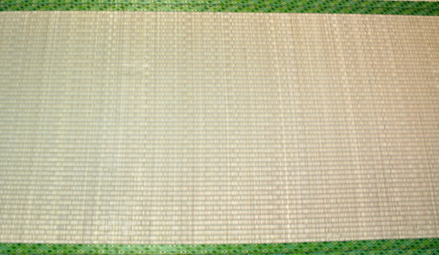
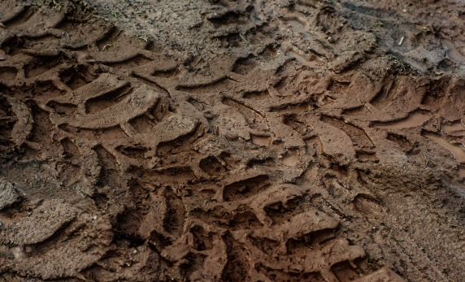
Building materials
They are mainly natural, for example:
Wood
Bamboo
Straw
Mud

Slide 4
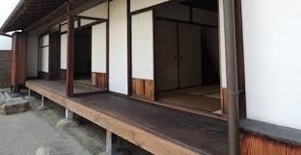
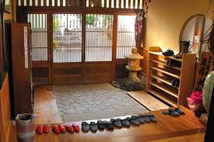
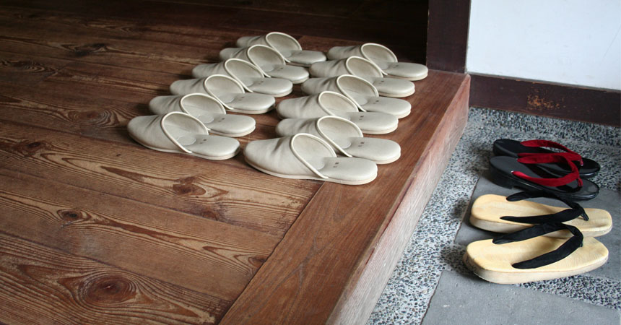
Parts of the house
Terrace (Engawa)
Entrance (Genkan)
Thanks to this custom of taking off shoes, dust does not get into the house and it stays clean.

Slide 5
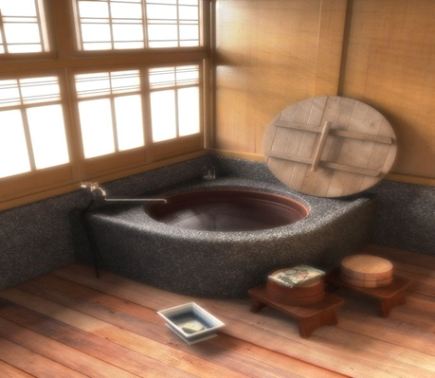
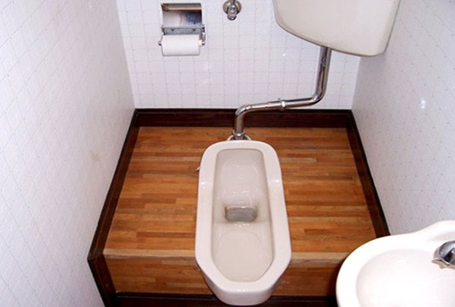
Bathroom
Bathing room (Ofuro)
Toilet and sink
Before you get into the water, you wash with the soap. Washing with soap inside the tub is not well-seen.

Slide 6
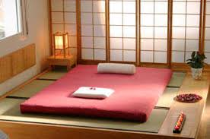
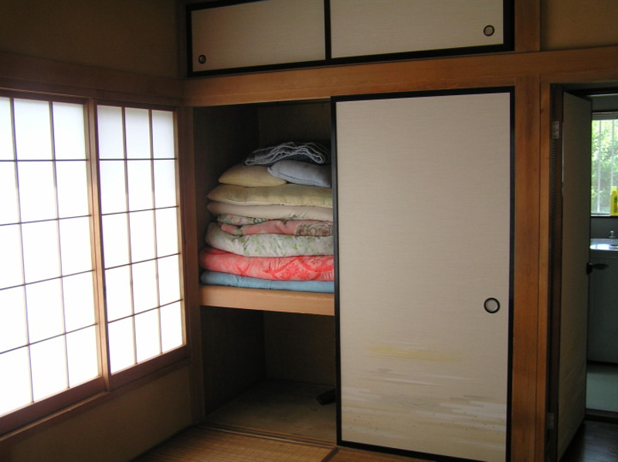
Bedroom
The bedroom with a futon
They are kept folded in the closet during the day

Slide 7
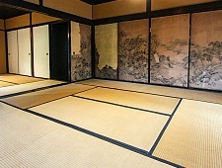
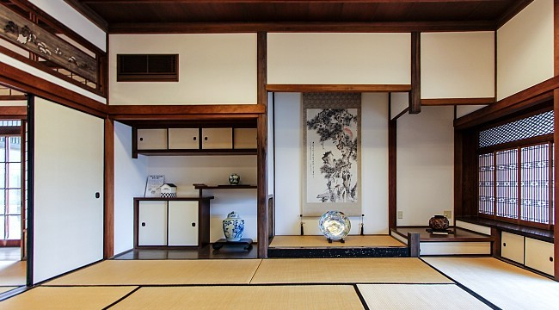
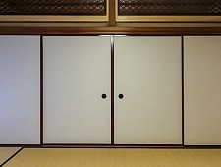
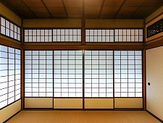
Traditional Elements
Floor. Tatami
Shelves. Chigaidana
Sliding doors. Fusuma
Translucent sliding doors. Shoji

Slide 8
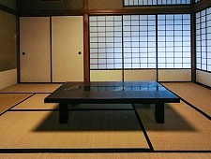
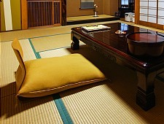
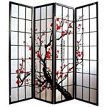
Common Furniture
Low tables
Cushinso
Portable folding partitions - Byobu

