Slide 1
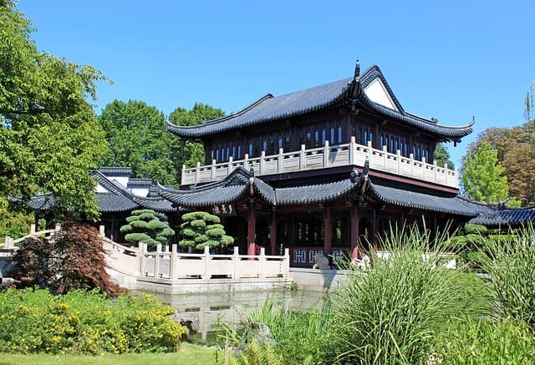
TYPICAL CHINESE HOUSE
(work by Paula and Sara)

Slide 2
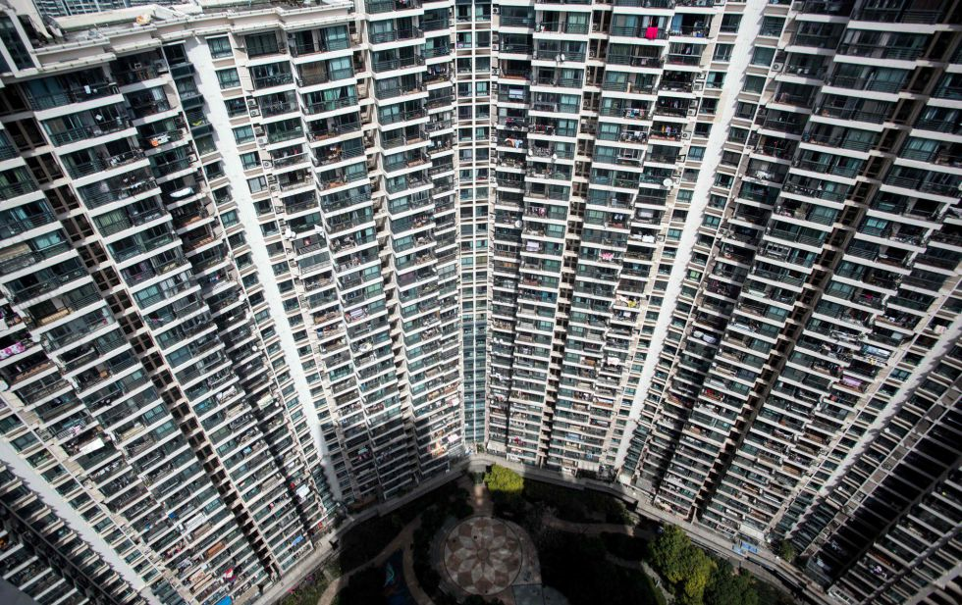
We are going to describe a modern Chinese house, it usually has two floors, though many Chinese people lives in flats like in this picture:

Slide 3
HALL
The hall has a normal door, you can’t enter with your shoes on, there is a cupboard to keep your shoes safe from dirt.

Slide 4
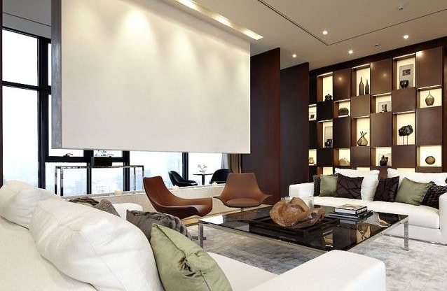
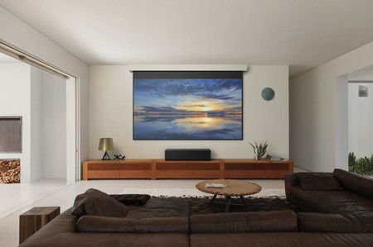
LIVING ROOM
The living room has an ultimate generation TV , it has a sofa and a coffee table.

Slide 5
KITCHEN
Chinese kitchens are usually made of wood , and with a bar in the middle , it has many drawers and cupboards.

Slide 6
DINING ROOM
Chinese dining rooms are very small with a big and round table in the middle, many people eat together.

Slide 7
MATRIMONIAL BEDROOM
The traditional matrimonial bedroom has a big double bed with too many pillows , big windows and it follows the rule of feng shui , it usually has plants.

Slide 8
KIDS’ BEDROOM

Slide 9
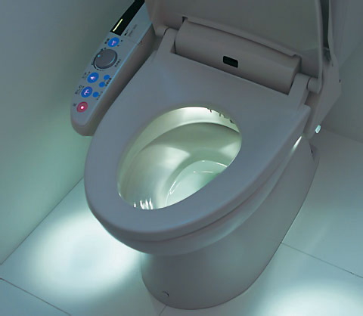
BATHROOM
Chinese bathrooms have a shower in the wall and an electric toilet that throws water because Chinese people are very clean.

Slide 10
GARAGE
Chinese garages are like a little house near their houses, they don’t have anything else, they use it only to put their cars.

Slide 11
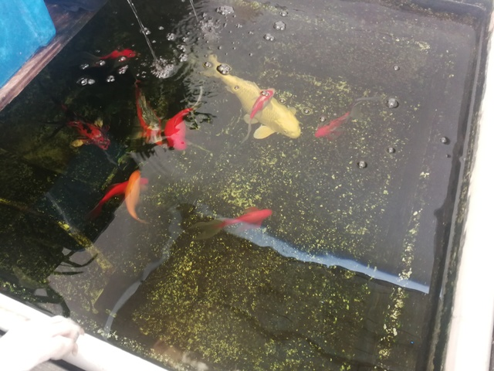
GARDEN
The garden has many plants ,the grass is very green and it usually has a tiny pond with Karpa fishes.

Slide 12
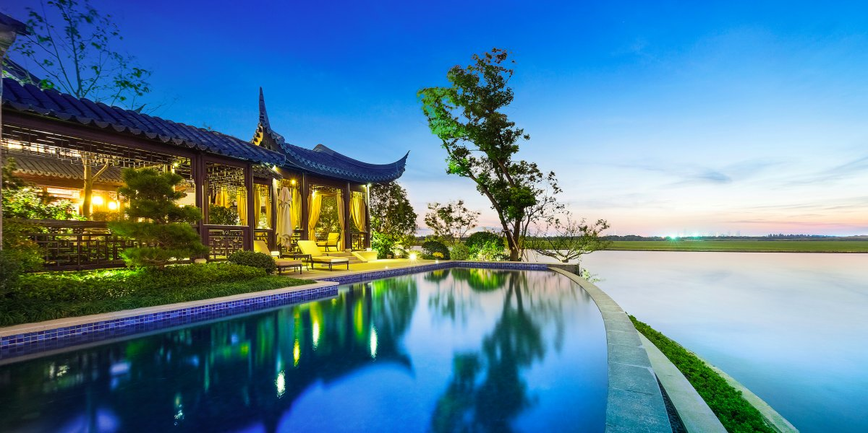
SWIMMING POOL
Chinese swimming pools are in the middle of their gardens, they are big and not very deep.
The millionaires have incredible pools.

Slide 13
THANKS

